Slide 1
The p-value: Replacing 0.05 with Understanding
Dr. Kari Lock Morgan
Department of Statistics
Pennsylvania State University
Joint Mathematics Meetings
Denver, CO
January 18th, 2020

Slide 2
Reproducibility Crisis
Study: half of the studies you read about in the news are wrong (Vox, 2017)
Why most published research findings are false (PLOS Medicine, 2005)
Is There a Reproducibility Crisis in Science? (Nature, 2016
90% of researchers surveyed say ”yes”
Poor replication validity of biomedical association studies reported by newspapers (PLOS One, 2017)
Amid a Sea of False Findings, the NIH Tries Reform (Chronicle of Higher Education, 2015)
“it is now a truism in the scientific establishment that many preclinical biomedical studies, when subjected to additional scrutiny, turn out to be false."
Estimating the reproducibility of psychological science (Science Mag, 8/28/2015)
tried to replicate 100 results published in psychology journals: 97% of the original results were significant, only 36% of replicated results were significant

Slide 3
p-Values to Blame?
The fickle p-value generates irreproducible results (Nature, 2/26/2015)
Basic and Applied Social Psychology journal banned p-values
“statistical techniques for testing hypotheses ...have more flaws than Facebook’s privacy policies.” (Siegfried, ScienceNews, 2014)
…

Slide 4
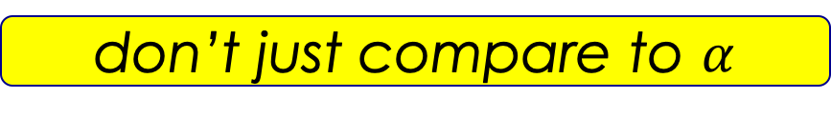
ASA Statement on Statistical Significance and P-Values (2016)
P-values can indicate how incompatible the data are with a specified statistical model.
P-values do not measure the probability that the studied hypothesis is true, or the probability that the data were produced by random chance alone.
Scientific conclusions and business or policy decisions should not be based only on whether a p-value passes a specific threshold.
Proper inference requires full reporting and transparency.
A p-value, or statistical significance, does not measure the size of an effect or the importance of a result.
By itself, a p-value does not provide a good measure of evidence regarding a model or hypothesis.
p-values can be useful
don’t misinterpret them
don’t just compare to $α$
p-values are not everything

Slide 5
Moving to a World Beyond p<0.05
Special Issue of The American Statistician: “Moving to a World Beyond “p < 0.05” (2019)
Collection of 43 papers on the topic
Editorial by Wasserstein, Schirm, & Lazer
2 education papers: Maurer et. al, Steel et. al.
Corresponding keynote address at the 2019 United States Conference on Teaching Statistics (USCOTS)

Slide 6
Moving to a World Beyond p<0.05
“The ASA Statement on P-Values and Statistical Significance stopped just short of recommending that declarations of “statistical significance” be abandoned. We take that step here. We conclude, based on our review of the articles in this special issue and the broader literature, that it is time to stop using the term “statistically significant” entirely. Nor should variants such as “significantly different,” “p < 0.05,” and “nonsignificant” survive, whether expressed in words, by asterisks in a table, or in some other way.”
- TAS Special Issue Editorial

Slide 7
What’s to Blame?
It’s not my fault!
STATISTICALLY SIGNIFICANT
p-value
?
< 0.05

Slide 8
What’s to Blame?
p-value > 0.05
p-value > 0.05
p-value > 0.05
p-value > 0.05
p-value > 0.05
p-value > 0.05
p-value > 0.05
p-value > 0.05
p-value > 0.05
p-value > 0.05
p-value > 0.05
p-value > 0.05
p-value > 0.05
p-value > 0.05
p-value > 0.05
p-value > 0.05
p-value > 0.05
p-value > 0.05
p-value > 0.05
p-value > 0.05
p-value > 0.05
p-value > 0.05
p-value > 0.05
p-value < 0.05
p-value > 0.05
p-value > 0.05
p-value > 0.05
p-value > 0.05
p-value > 0.05
p-value > 0.05
p-value > 0.05
p-value > 0.05
p-value > 0.05
p-value > 0.05
p-value > 0.05
p-value > 0.05
p-value > 0.05
p-value > 0.05
p-value > 0.05

Slide 9
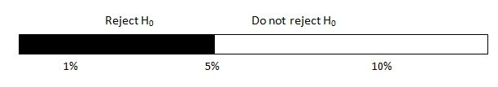
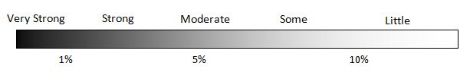
Interpreting a p-Value
Black and white decision, based on α = 0.05 :
Shades of grey:

Slide 10
What’s to Blame?
p-value
< 0.05
“I have no clue what this is, but it’s less than 0.05.”
“and that’s all that matters”

Slide 11
Moving to a World Beyond p<0.05
“… we are not recommending that the calculation and use of continuous p-values be discontinued. Where p-values are used, they should be reported as continuous quantities (e.g., p = 0.08). They should also be described in language stating what the value means in the scientific context. We believe that a reasonable prerequisite for reporting any p-value is the ability to interpret it appropriately.”
- TAS Special Issue Editorial

Slide 12
Three Challenges
Scientific convention
Thinking is harder than p < 0.05
3) Conclusions are fun/exciting

Slide 13
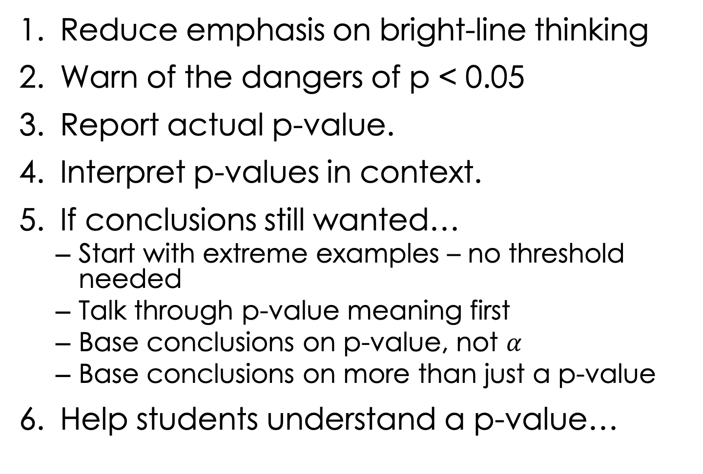
What to Do in Intro?
Reduce emphasis on bright-line thinking
Warn of the dangers of p < 0.05
Report actual p-value.
Interpret p-values in context.
If conclusions still wanted…
Start with extreme examples – no threshold needed
Talk through p-value meaning first
Base conclusions on p-value, not $α$
Base conclusions on more than just a p-value
Help students understand a p-value…

Slide 14
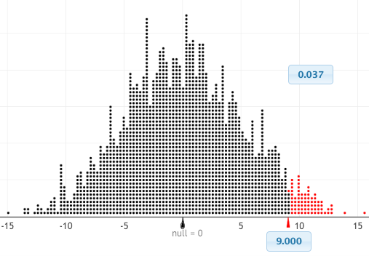
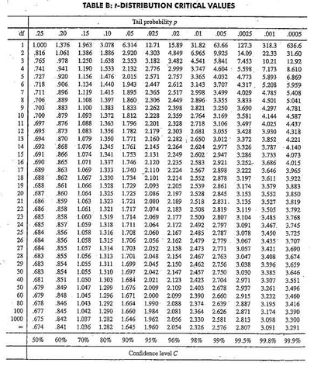
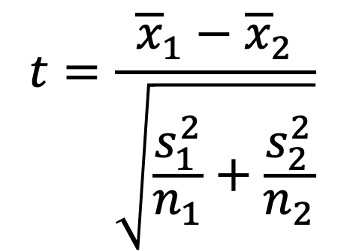
Understanding a P-Value
$$t=\frac{{\overline{x}}_{1}−{\overline{x}}_{2}}{\sqrt{\frac{s_{1}^{2}}{n_{1}}+\frac{s_{2}^{2}}{n_{2}}}}$$
Simulation-based inference!

Slide 15
Pay Individually or Split Evenly?
When going out to eat as a group, people may pay individually or split the bill evenly
If this decision is made in advance, does it change how much people spend?
48 Israeli college students went out to eat in groups of 6. Whether they would pay individually or split evenly was determined in advance…
… randomly!
Gneezy, U.,Haruvy, E., and Yafe, H. "The Inefficiency of Splitting the Bill,"" The Economic Journal, 2004; 114, 265-280.
Frasca Food & Wine
Notes:
Frasca Food & Wine

Slide 16
Pay Individually or Split Evenly?
$${\overline{Y}}_{I}−{\overline{Y}}_{S}=37.29−50.92=−13.63$$
Notes:
Frasca Food & Wine

Slide 17
Pay Individually or Split Evenly?
Meal cost higher for splitting students
Two explanations:
People spend more when splitting
No difference; just random chance
What kinds of results would we see, just by chance, if there were no difference?
We can simulate to find out!!!

Slide 18
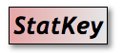

Simulating Random Chance
Cost | Group
59
16
39
12
. . . | . . .
54
40
45
37
Assume no difference (cost the same regardless of payment method)
Mimic random chance: Re-randomize into groups
Compute the statistic (difference in means)
4. Do this thousands of times!
S
I
S
I
$${\overline{Y}}_{I}−{\overline{Y}}_{S}=−2.38$$
I
I
S
S

Slide 19
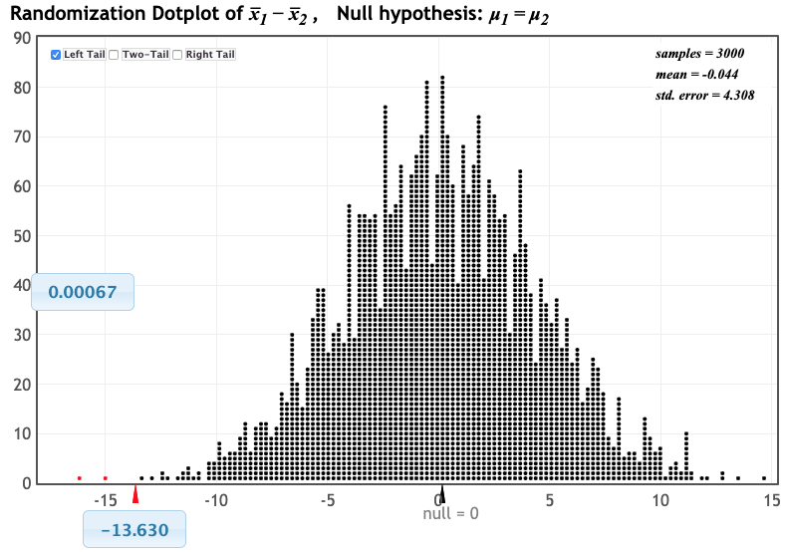
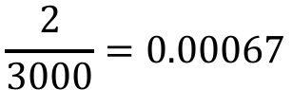
p-Value
Distribution of statistic if H₀ true
p-value!
Proportion as extreme as observed statistic
$$\frac{2}{3000}=0.00067$$
observed statistic

Slide 20
I have a p-value. What next?
Interpret p-value in context.
If paying individually versus splitting the bill does not change meal cost, we would only see differences as extreme as the -13.63 we observed in 7 out of 10,000 samples.

Slide 21
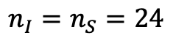
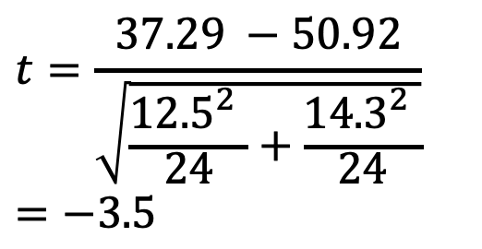
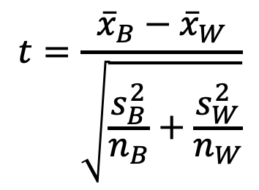
p-Value (a different way)
1. Check conditions
$$n_{I}=n_{S}=24$$
2. Which formula?
$$t=\frac{{\overline{x}}_{B}−{\overline{x}}_{W}}{\sqrt{\frac{s_{B}^{2}}{n_{B}}+\frac{s_{W}^{2}}{n_{W}}}}$$
3. Plug and chug
$$t=\frac{37.29 −50.92}{\sqrt{\frac{{12.5}_{}^{2}}{24}+\frac{{14.3}_{}^{2}}{24}}}=−3.5$$
What’s a p-value?!?
4. Which theoretical distribution?
5. df?
6. Find p-value
0.0005 < p-value < 0.001

Slide 22
p-value: The chance of obtaining a statistic as extreme as that observed, just by random chance, if the null hypothesis is true
p-value: The chance of obtaining a statistic as extreme as that observed, just by random chance, if the null hypothesis is true
p-value: The chance of obtaining a statistic as extreme as that observed, just by random chance, if the null hypothesis is true
p-value: The chance of obtaining a statistic as extreme as that observed, just by random chance, if the null hypothesis is true
p-value: The chance of obtaining a statistic as extreme as that observed, just by random chance, if the null hypothesis is true

Slide 23
National Assessment Results
Huge improvement on p-value questions!
 | Nat’l | PSU Comparison | Trad | SBI
Able to reason that a smaller p-value provides stronger evidence against the null hypothesis than a larger p-value.
Able to reason about a conclusion based on a statistically significant p-value in the context of a research study that compares two groups.
Intro Biostat
Intro Stat
Instructor 1
Instructor 2
29%
44%
38%
50%
68%
59%
70%
73%
45%
Intro Biostat
Intro Stat
Instructor 1
Instructor 2
48%
57%
53%
59%
80%
71%
77%
78%
43%

Slide 24
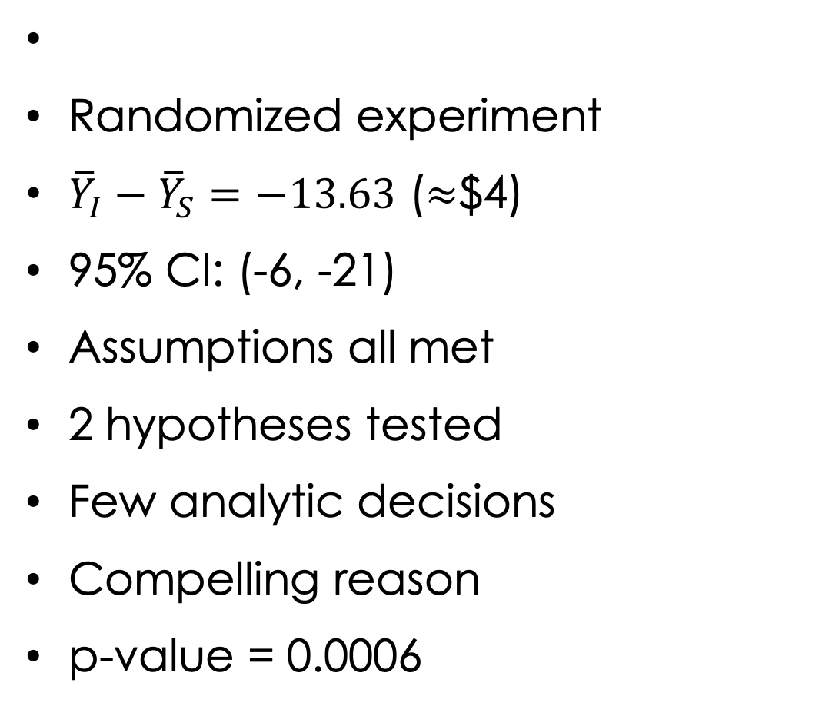
p-Value isn’t everything!
Randomized experiment
${\overline{Y}}_{I}−{\overline{Y}}_{S}=−13.63$ ($≈$$4)
95% CI: (-6, -21)
Assumptions all met
2 hypotheses tested
Few analytic decisions
Compelling reason
p-value = 0.0006
We have strong evidence that, for Israeli college students, advance knowing ahead of time that the bill will be split evenly increases meal cost.

Slide 25

Moving Forward
Regarding the p-value, we can start…
Replacing p<0.05 With Understanding

